Slide 1
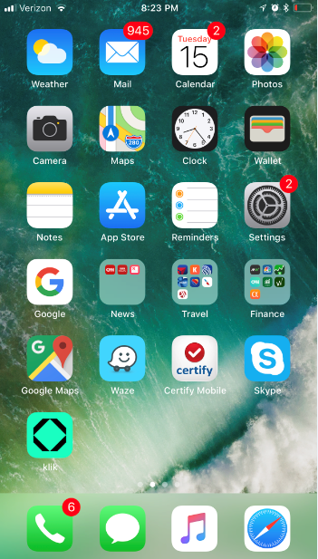
Cell Phone Setup
www.sp2systems.com
Paul Dickson
470-234-2955
paul@sp2systems.com

Slide 2
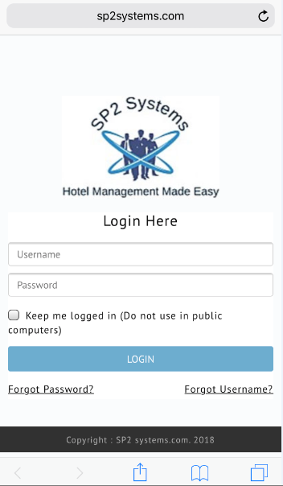
Cell Phone Setup
www.sp2systems.com
Paul
Pass123
Paul Dickson
470-234-2955
paul@sp2systems.com

Slide 3
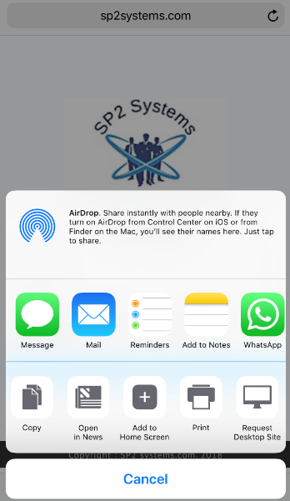
Cell Phone Setup
www.sp2systems.com
Paul Dickson
470-234-2955
paul@sp2systems.com

Slide 4
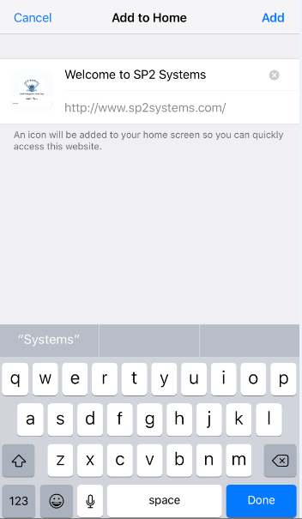
Cell Phone Setup
www.sp2systems.com
Paul Dickson
470-234-2955
paul@sp2systems.com

Slide 5
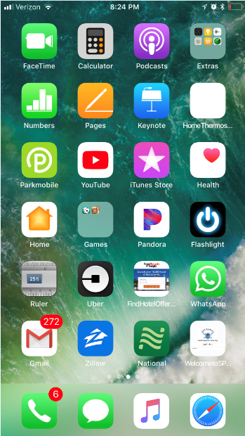
Cell Phone Setup
www.sp2systems.com
Paul Dickson
470-234-2955
paul@sp2systems.com

Slide 6
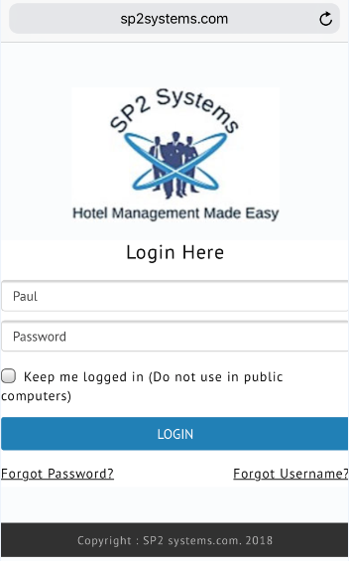
Cell Phone Setup
www.sp2systems.com
Paul Dickson
470-234-2955
paul@sp2systems.com

Slide 7
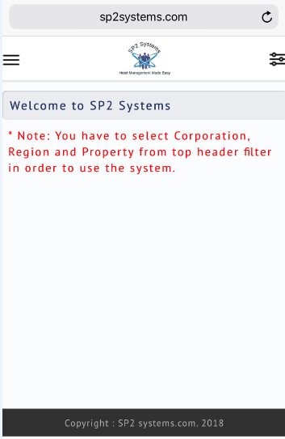
Cell Phone Setup
www.sp2systems.com
Paul Dickson
470-234-2955
paul@sp2systems.com

Slide 8
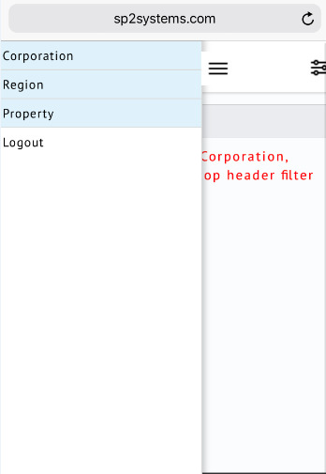
Cell Phone Setup
www.sp2systems.com
Paul Dickson
470-234-2955
paul@sp2systems.com

Slide 9
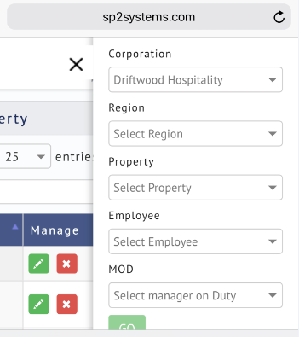
Cell Phone Setup
www.sp2systems.com
Paul Dickson
470-234-2955
paul@sp2systems.com

Slide 10
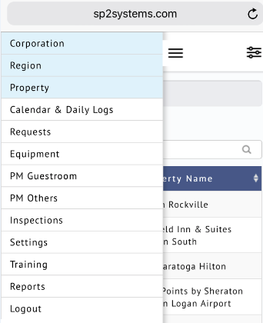
Cell Phone Setup
www.sp2systems.com
Paul Dickson
470-234-2955
paul@sp2systems.com

Slide 11
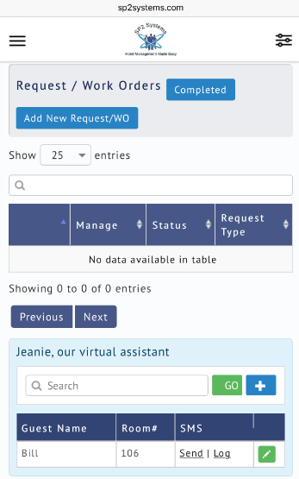
Cell Phone Setup
www.sp2systems.com
Paul Dickson
470-234-2955
paul@sp2systems.com

Slide 12
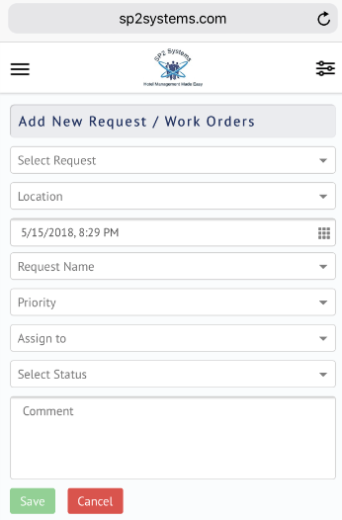
Cell Phone Setup
www.sp2systems.com
Paul Dickson
470-234-2955
paul@sp2systems.com

Slide 13
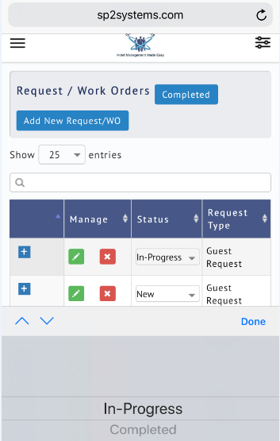
Cell Phone Setup
www.sp2systems.com
Paul Dickson
470-234-2955
paul@sp2systems.com

Slide 14
Cell Phone Setup
www.sp2systems.com
www.sp2systems.com
Paul Dickson
470-234-2955
paul@sp2systems.com
Paul Dickson
470-234-2955
paul@sp2systems.com

